Slide 1

Revolutionizing Dating: Introducing Our AI-Powered Matchmaking App
Transforming connections through innovative technology
Notes:
AI-generated content may be incorrect. --- This presentation will introduce an innovative AI-powered matchmaking app designed to transform the dating experience. We'll discuss its unique concept, the role of AI in enhancing matchmaking, and the criteria for matching users. We'll also share success stories from users who found meaningful connections through the app. Image source: Microsoft 365 content library

Slide 2
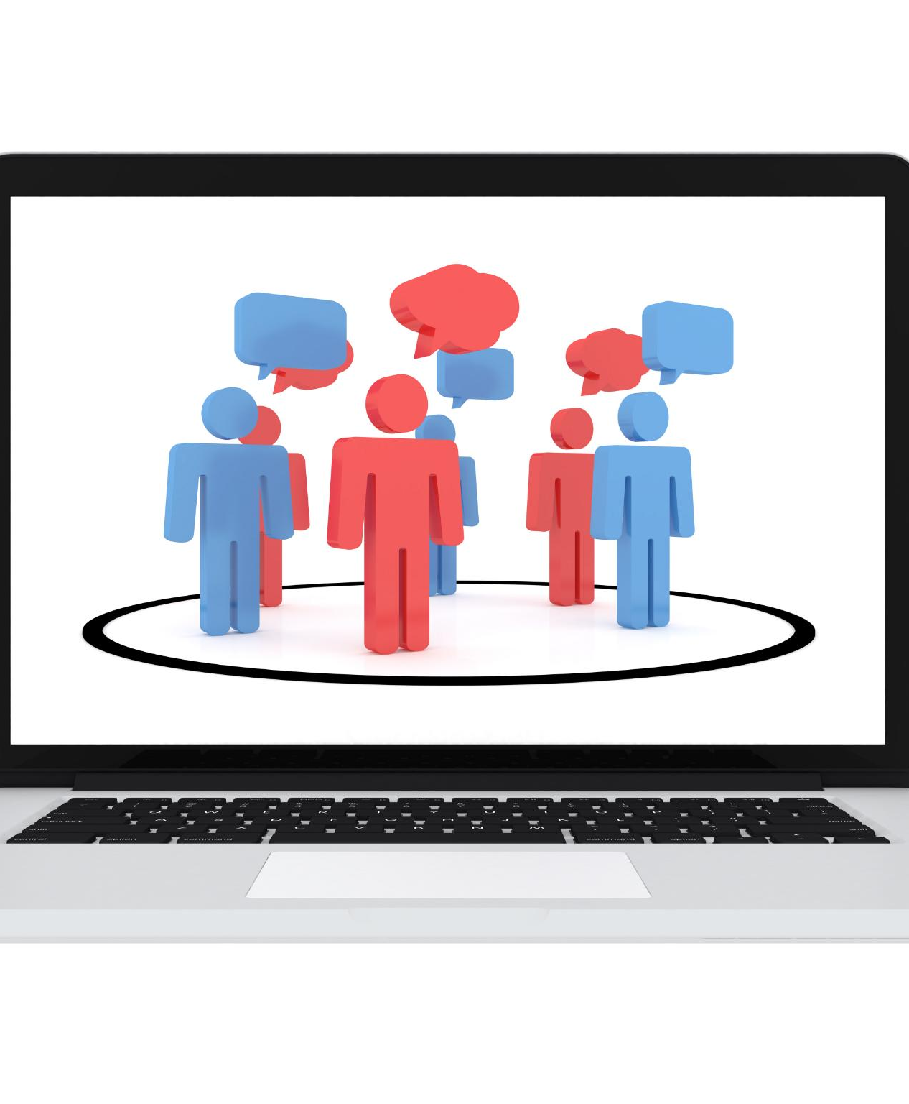
Overview of the App's Unique Concept
AI-Driven Matchmaking
The app utilizes advanced AI technology to offer personalized partner suggestions based on user preferences and interests.
Engaging Conversation Prompts
The app fosters genuine connections by providing engaging conversation prompts to help users break the ice and connect meaningfully.
Personalized User Experience
By integrating user preferences, the app creates a personalized experience that enhances user interaction and satisfaction.
Notes:
--- The app stands out by integrating AI technology with personalized matchmaking. It not only suggests potential partners based on preferences but also fosters genuine connections through engaging conversation prompts and activities. Image source: Microsoft 365 content library

Slide 3
Target Audience: People in Their 20s Seeking Long-Term Relationships
Young Adults Focus
The primary audience is composed of young adults in their 20s seeking serious, long-term relationships.
Desire for Serious Connections
This audience prefers meaningful interactions over casual dating, seeking deeper emotional connections.
Supportive Environment
The app provides a supportive and engaging atmosphere that fosters genuine connections among users.
Notes:
--- Our primary audience consists of young adults in their 20s who are looking for serious relationships rather than casual dating. The app meets their needs by providing a supportive and engaging environment for meaningful interactions. Image source: Microsoft brand library

Slide 4

Role of the AI Agent as a Matchmaker
Personalized Matching
The AI agent curates profiles tailored to user preferences, ensuring a more relevant matchmaking experience.
Learning from Behavior
The AI agent continuously learns from user interactions, improving match suggestions over time, enhancing user satisfaction.
Enhanced User Experience
By refining suggestions, the AI agent enhances the overall matchmaking experience for users, leading to better outcomes.
Notes:
--- The AI agent acts as a personal matchmaker, curating profiles based on user preferences and interactions. It continuously learns from user behavior to improve match suggestions and enhance the overall experience. Image source: Microsoft brand library

Slide 5
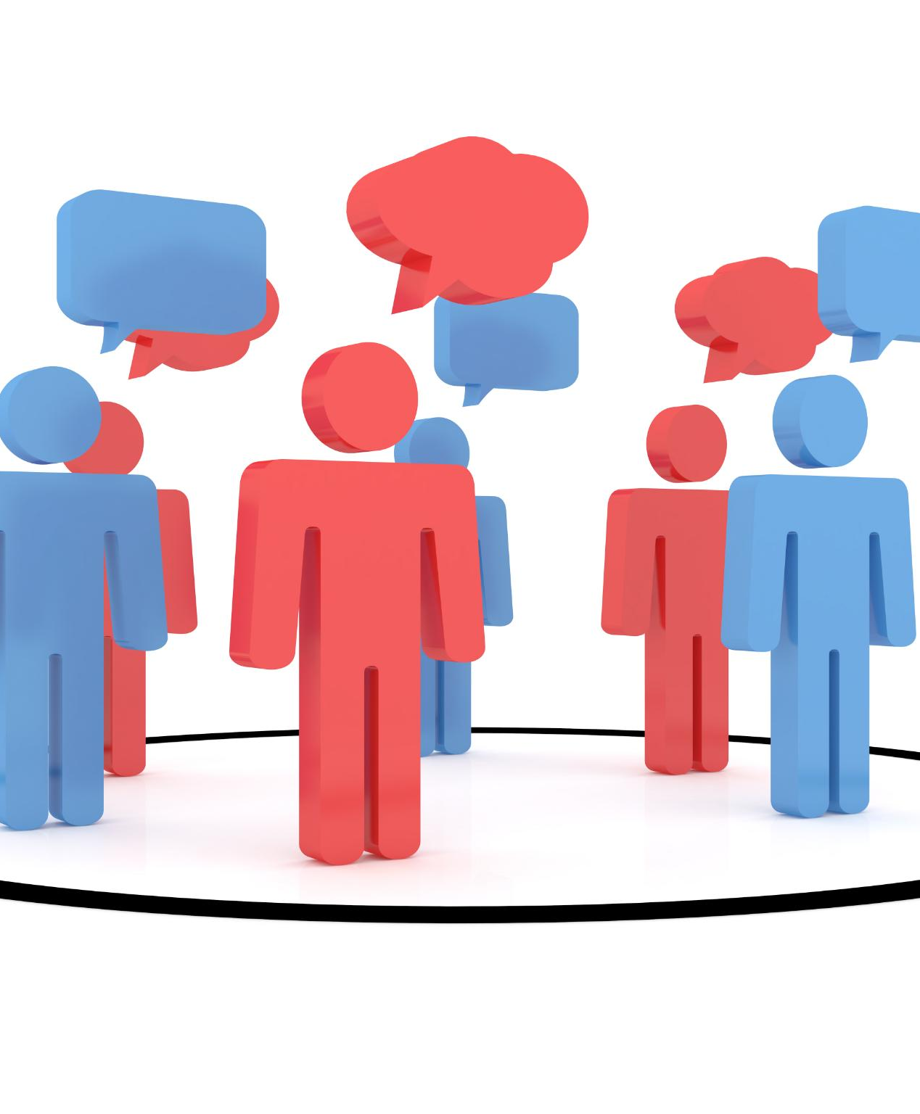
Evaluating Chatting Styles and Profiles
Communication Styles Evaluation
The app analyzes users' communication styles to assess their preferences and interactions effectively.
User Profiles Compatibility
By evaluating user profiles, the app can determine compatibility and improve matching accuracy.
Enhancing Matching Process
Understanding how users interact allows for refined matching strategies that promote better connections.
Notes:
--- The app evaluates users' communication styles and profiles to gauge compatibility. By understanding how users interact and express themselves, we can enhance the matching process. Image source: Microsoft 365 content library

Slide 6
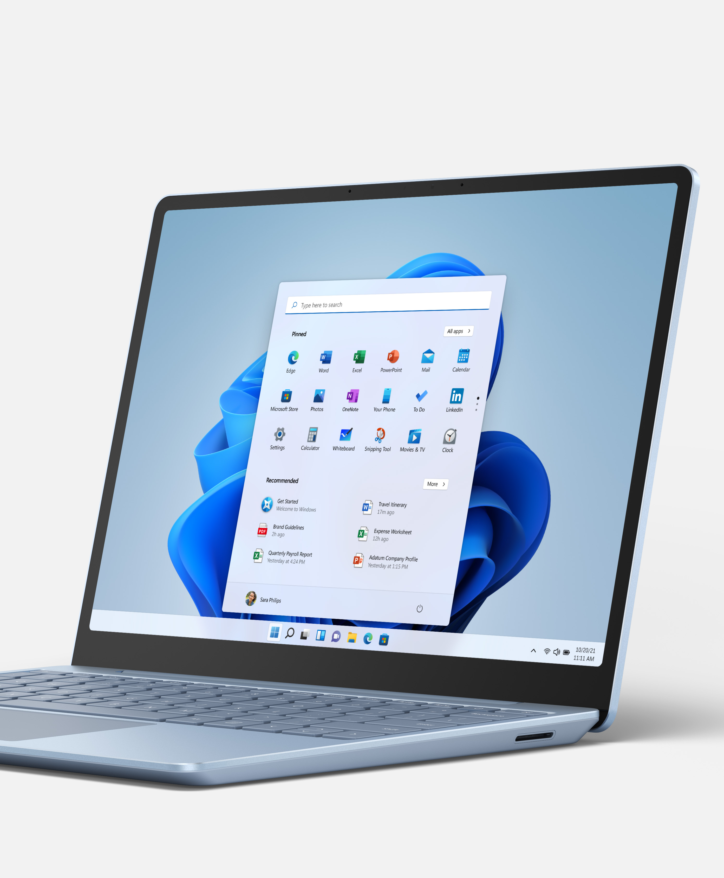
Setting up Initial Conversations Between Matches
Guided Conversation Features
The app provides users with tools to initiate conversations, making the process easier and more comfortable.
Icebreakers for Engagement
Icebreakers are designed to reduce anxiety and help users feel more at ease when starting a conversation.
Encouraging User Interaction
By enhancing engagement from the outset, the app fosters meaningful connections between users and encourages open communication.
Notes:
--- The app includes features that guide users in starting their first conversations, such as icebreakers and conversation starters. This reduces anxiety and encourages engagement from the outset. Image source: Microsoft brand library

Slide 7
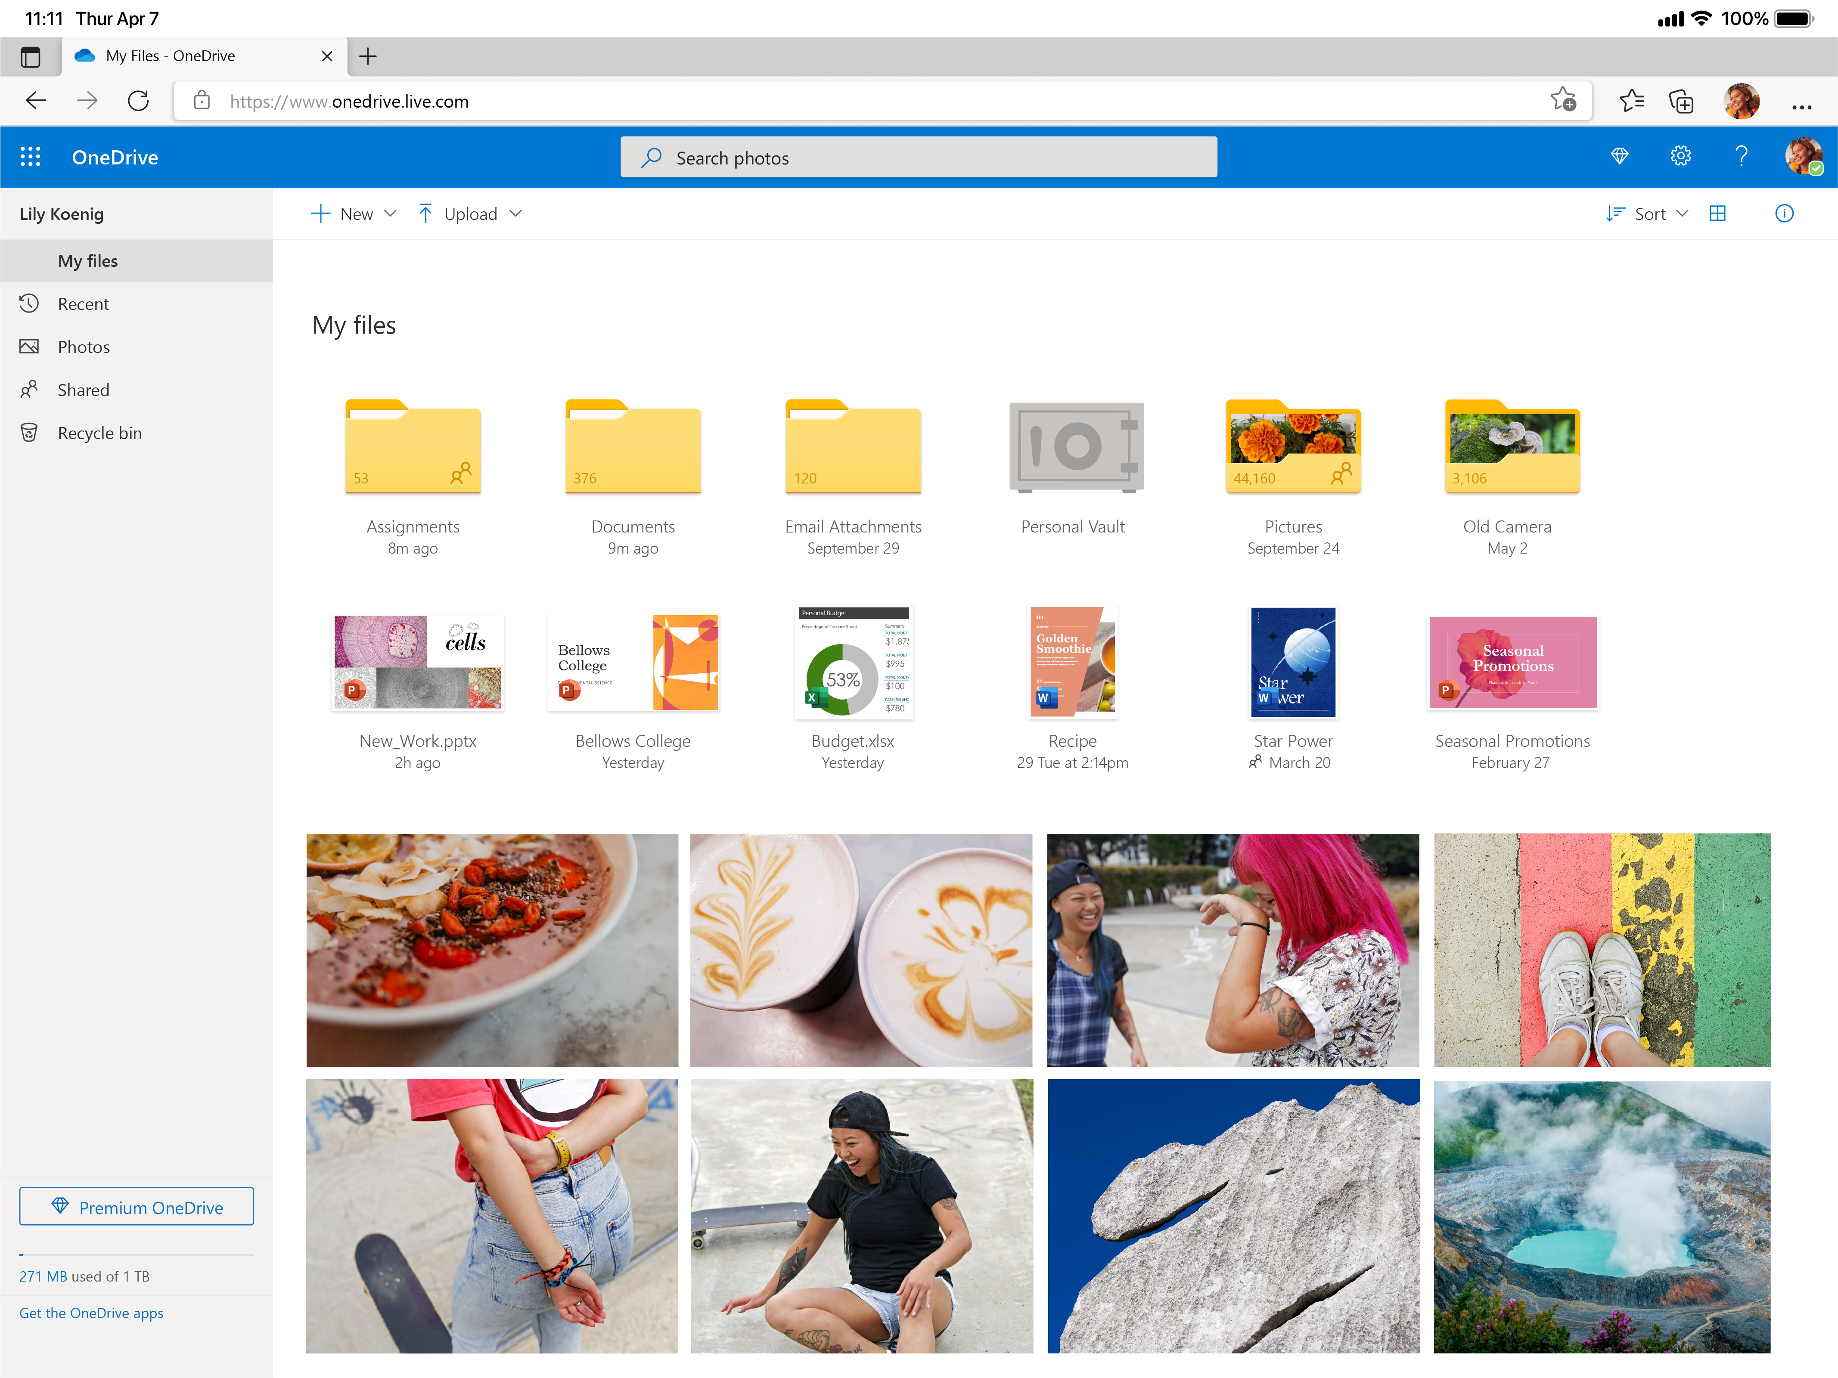
User Feedback and App Reviews
Positive User Feedback
Users have expressed satisfaction with the app's matchmaking features, praising its innovative approach.
User-Friendly Interface
Reviews consistently highlight the app's user-friendly interface, making navigation and usage easy for all.
Quality of Matches
Many users report high-quality matches, contributing to a positive overall experience with the app.
Notes:
--- User feedback has been overwhelmingly positive, with many mentioning the app's unique approach to matchmaking. Reviews highlight the app's user-friendly interface and the quality of matches. Image source: Microsoft brand library

